Slide 1

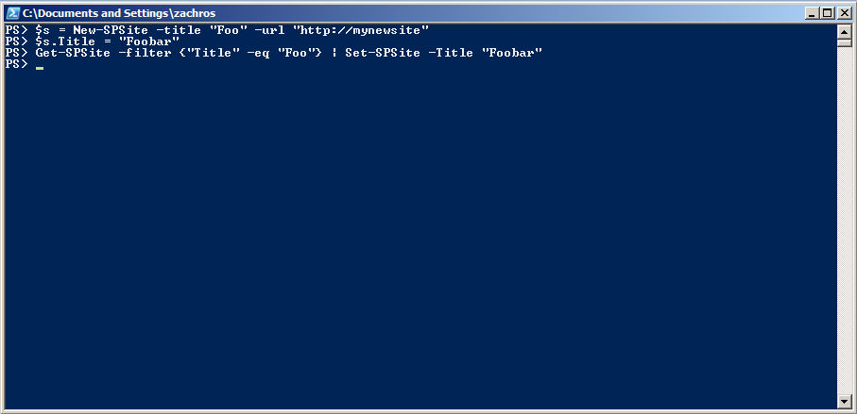



The Art of PowerShell Toolmaking
Kurt Roggen [BE]
Principal Consultant
me@kurtroggen.be
http://kurtroggen.be
@roggenk
roggenk

Slide 2
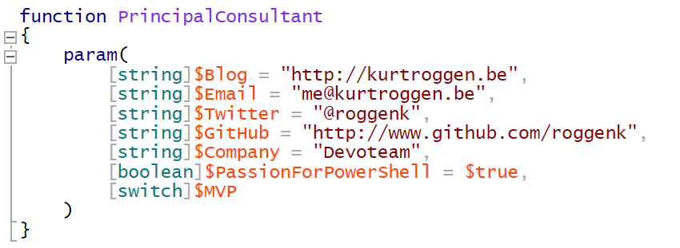
about_KurtRoggen

Slide 3
Agenda
Modules… Modules… Modules
Module Creation
Module Management

Slide 4

Module Creation

Slide 5
3 cmdlets to know/remember!!
PowerShell is self-discoverable using
Get-Command
Get-Help
Get-Member

Slide 6
#1. Get-Command
Displays all commands (cmdlet, function, alias)
Get-Command
Get-Command -Verb get
Get-Command -Noun service
Get-Command -Module ActiveDirectory
Get-Command -CmdType cmdlet
Get-Command -Syntax
Alias: gcm

Slide 7
#2. Get-Help
Displays help information
Get-Help
Get-Help get-service
Get-Help get-service -Examples
Get-Help get-service -Detailed
Get-Help get-service -Full
Get-Help get-service -Online
Get-Help get-service -Parameter ComputerName
Get-Help * -Parameter ComputerName
Get-Help about_wildcards
Alias: help
Notes:
Check out about_Regular_Expressions

Slide 8
#3. Get-Member
Displays object model with all MemberTypes
(Property, Method, AliasProperty, ScriptMethod, ...)
Get-Service | Get-Member
Get-Member –InputType (Get-Service)
Get-Member –MemberType Method
Get-Member –MemberType Property
Alias: gm

Slide 9
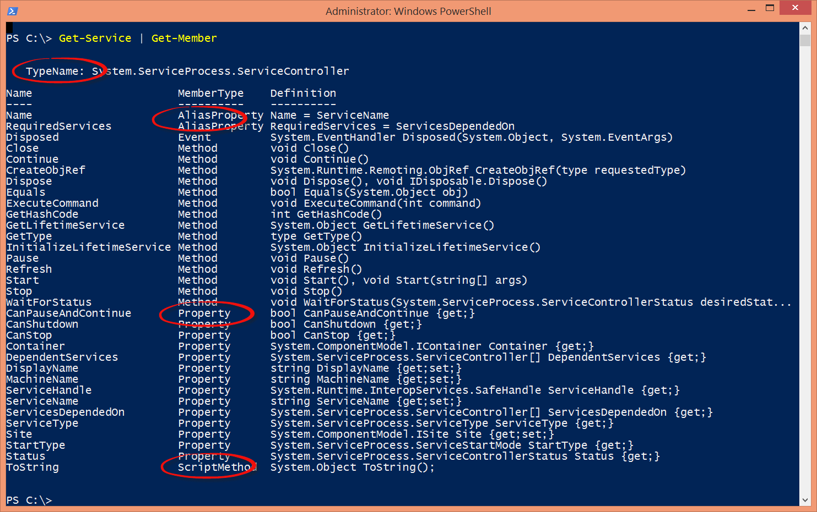
Get-Member

Slide 10

Consistency… Consistency… Consistency!
Consistent behavior across all PowerShell cmdlets
For Cmdlet naming
For Parameter usage and naming
For Object (model) and Property/Method naming
Makes learning and remembering faster and easier
“Think – Type – Get”

Slide 11
Cmdlet Naming
Use strict Verb-<Prefix>SingularNoun convention
Make guessing easy ⇨ “Think – Type – Get”
Use only approved verbs
PowerShell warns about unapproved verbs at module load time
Approved verbs: Get-verb
Workaround
Define alias, using New-Alias –Name <VerbAlias-Noun> -Value <cmdlet>

Slide 12
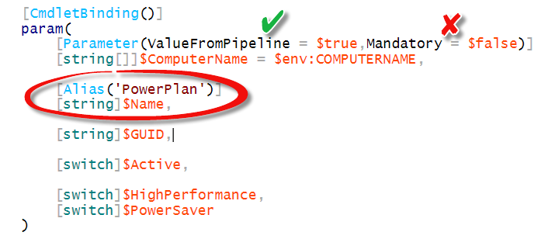
Parameter Naming
Use consistent parameter names across all cmdlets
Examples:
-ComputerName
-CimSession
-Name
Parameter name should match object names
Workaround
Define alias parameter

Slide 13
Object Model and Property Naming
Parameter name should match object names
Workaround
Define “Alias Property”
Example:
‘Name’ (alias)property

Slide 14
Module Anatomy

Slide 15
PowerShell Module Anatomy
ModuleName (directory)
ModuleName.psd1 (module manifest)
ModuleName.psm1 (module script)
*.dll (binaries)
*.Format.ps1xml *.Types.ps1xml
(format & type extensions)
*.ps1 (scripts)
Resources (help, languages, Pester, snippets, DSC, ...)

Slide 16

PowerShell Module Components
DEMO
Module Script - .PSM1
Module Manifest – .PSD1
Create PS module folder
Save PS module as .PSM1 instead of .PS1
PS module folder name must match PS module file name
Locations
$env:PSModulePath
Metadata about module
Version, Author,
Formats, Types
Export Aliases, Variables, Functions, …
Requirements
PS Host, Version, .NET, CLR
Required for publishing to PowerShell Gallery
Cmdlet: New-ModuleManifest

Slide 17
Module Script - .psm1
Advanced Functions
Aliases
Scope (global, local, script)
Variables
Scope (global, local, script)
$script:variable1
$global:variable2

Slide 18
What do you export from your module?
Decide what information to export from your module
Function
Aliases
Variables
Defined in PSM1
Defined in PSD1
Using Export-ModuleMember
-Alias *
-Variable *DivaNET*, DIVA*
-Function *
Overrides psd1 keywords
Using keywords “*ToExport”:
FunctionsToExport = '*'
CmdletsToExport = '*'
AliasesToExport = '*'
VariablesToExport = '*'

Slide 19
Help

Slide 20
Create your own Help
Provide specific help information for
Function usage (Description, Synopsis)
Parameters
Examples
Related functions (Link)
Provide general help information for topics or modules
about_<topic>.help.txt
about_<module>.help.txt ()

Slide 21
PowerShell Help Options
Comment Based Help
XML Based Help (MAML)
Internal help
Included in script/module
Based on .keywords inside comment block
Simple
External help
Separate help files
Supports multi-language
More complex
Tools: SAPIEN PowerShell Help Writer
Supports updatable help
Requires HelpInfoURI keyword in module manifest

Slide 22

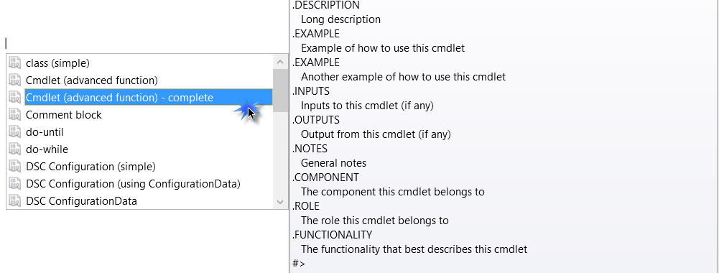
Comment Based Help
Function Get-OS
{
<#
.SYNOPSIS <This is what the function is does>
.DESCRIPTION <This is what the function does but more detailed.>
.PARAMETER ComputerName <Describe each parameter purpose and usage>
.EXAMPLE Get-OS
Will retrieve the OS version of the computer.
.LINK http://mysite.com/get-os/
.LINK
Get-ServicePack Get-BIOS
#>
Param ( [string]$ComputerName, [switch]$Details )
}
Use ISE Snippets (Control+J)
about_Comment_Based_Help
https://technet.microsoft.com/en-us/library/hh847834.aspx

Slide 23
Updatable XML based Help
XML based – MAML
Requires several components
.psd1 – keyword HelpInfoURI
HelpInfo.xml
.psm1-Help.xml file
CAB file
Syntax: ModuleName_ModuleGUID_UI-Culture_HelpContent.cab
Example: TestModule_d03c1cf3-f738-48a3-b845-5ead46a52671_en-US_HelpContent.cab
about_Updatable_Help - https://technet.microsoft.com/en-us/library/hh847735.aspx
https://msdn.microsoft.com/en-us/library/windows/desktop/hh852735(v=vs.85).aspx
Notes:
https://msdn.microsoft.com/en-us/library/windows/desktop/hh852735(v=vs.85).aspx

Slide 24
Updatable Help Anatomy
ModuleName (directory)
ModuleName.psm1 (module script)
HelpInfo.xml file
Language specific
HelpContent.cab
ModuleName.psd1 (module manifest)
HelpInfoURI key
.ps1
.dll

Slide 25

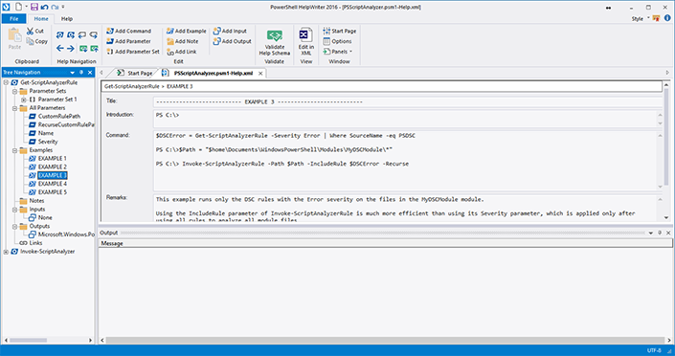
SAPIEN PowerShell HelpWriter 2016
For writing and editing Windows PowerShell help files.
Can convert comment-based help to MAML files.

Slide 26

Mark Down based Help
Markup language used to author documentation
Markdown (.MD) help system used for GitHub
Designed to be human-readable without rendering
Focused on simplicity
Easy to write and edit
Generate markdown (MD) files from PowerShell Help using
Command/Function
Module
MAML based help file
Using PowerShell Module ‘PlatyPS’
Available in PowerShell Gallery
Examples:
New-MarkdownHelp -Command <cmdlet> -OutputFolder .\docs
New-MarkdownHelp -Module <module> -OutputFolder .\docs
New-MarkdownHelp -MamlFile $MamlPath -OutputFolder .\docs
Notes:
https://blogs.msdn.microsoft.com/powershell/2016/02/05/platyps-write-external-help-files-in-markdown/

Slide 27
Objects

Slide 28
Create your own objects
Naming of Property, Method
Add additional members
AliasProperty
ScriptProperty
ScriptMethod

Slide 29
Create your own Objects
Using Add-Member
Using New-Object with HashTable
New-Object PSObject
Add-Member ` -Name <Name> ` -Value <Value> ` -MemberType <Type>
Allows AliasProperty, ScriptProperty, ScriptMethod
New-Object –TypeName PSObject –Property $<HashTable>
Using Type casting $Obj=[pscustomobject][ordered]@{ ComputerName = $ComputerName Value = ‘abc’ }
Makes code more readable

Slide 30
Create PS Object Using New-Object and Add-Member
$Obj = New-Object –Type PSObject
$Obj | Add-Member –Name ComputerName –Value $ComputerName –Type NoteProperty $Obj | Add-Member –Name OS –Value $OS –Type NoteProperty $Obj | Add-Member –Name ServicePack –Value $ServicePack –Type NoteProperty $Obj | Add-Member –Name Version –Value $ComputerName –Type NoteProperty
$Obj | Add-Member –Name Name –Value Version –Type AliasProperty
Return PS Object (to pipeline)
$Obj

Slide 31
Create PS Object Using Hashtable
$Properties = @{
Name = “Kurt”
LastName = “Roggen”
FullName = “Kurt Roggen”
ComputerName = “$env:COMPUTERNAME”
}
$Obj = New-Object –Type PSObject –Property $Properties
Return PS Object (to pipeline)
$Obj

Slide 32
Create your own Object Type
$Obj = New-Object –Type PSObject
$Obj.PSTypeNames.Insert(0,’myModule.Computer’)
Related methods:
$Object.PSTypeNames.Add(‘myModule.Computer’)
$Object.PSTypeNames.Remove(‘myModule.Computer’)

Slide 33
Extend your own Objects
Using Add-Member
Using <Module>.types.PS1XML
Simple
Explicit
Straight forward
Advanced
Implicit
Requires TypesToProcess keyword in module manifest

Slide 34
Extend your own Objects Using Add-Member
$obj = [pscustomobject]@{Name='Kurt Roggen'; FirstName='Kurt'; LastName='Roggen'}
With AliasProperty
Add-Member -InputObject $obj -MemberType AliasProperty -Name FullName
-Value Name
With ScriptProperty
Add-Member -InputObject $obj -MemberType ScriptProperty -Name MyFullName
-Value { $this.Firstname + ' ' + $this.LastName.ToUpper() }
With ScriptMethod
Add-Member -InputObject $obj -MemberType ScriptMethod -Name GetAddress
-Value $function:GetAddress
$obj.GetAddress()

Slide 35
Extend your own Objects Using types.ps1xml file
DEMO
Extends object type
Defines additional members (properties and methods)
Using XML file <ModuleName>.types.PS1XML
Create from default PowerShell type files as template
Requires “TypesToProcess” keyword in module manifest
about_Types
https://technet.microsoft.com/en-us/library/hh847881.aspx

Slide 36
Support the Pipeline Accept Pipeline Input using “ValueFromPipeline”
function Get-OS
{
param(
[Parameter(ValueFromPipeLine)]
[string[]]$ComputerName = $env:COMPUTERNAME
)
PROCESS
{
<foreach $Computer in $ComputerName…>
}
}

Slide 37
Support the Pipeline Accept Pipeline Input using “ValueFromPipelineByPropertyName”
function Get-OS
{
param(
[Parameter(ValueFromPipeLineByPropertyName)]
[string[]]$ComputerName = $env:COMPUTERNAME
)
PROCESS
{
<foreach $Computer in $ComputerName…>
}
}

Slide 38
Views/Formats

Slide 39
Create your own view/format
DEMO
Apply custom view/format onto objects
format.PS1XML file
Formatting definitions
Create from default PowerShell (format) views
View Types
Table view (format-table)
List view (format-list)
Requires keyword FormatsToProcess in module manifest
about_Format.ps1xml
https://technet.microsoft.com/en-us/library/hh847831.aspx
Notes:
https://technet.microsoft.com/en-us/library/hh847831.aspx

Slide 40
Parameters

Slide 41
Parameter Usage
Use Advanced Functions with Common Parameters
Use Parameter Sets
Use Validation Sets

Slide 42
Use “Common Parameters”
Parameters provided by PowerShell
Using [CmdletBinding()]
-Verbose, -Debug, -ErrorAction, -OutVariable, …
[CmdletBinding()]
-WhatIf, -Confirm
[CmdletBinding(SupportsShouldProcess=$true, ConfirmImpact='High')]
about_CommonParameters
https://technet.microsoft.com/en-us/library/hh847884.aspx

Slide 43
Create verbose output for troubleshooting
Write-Verbose –Message <message>
Write-Warning –Message <message>
Write-Error –Message <message>
Write-Debug –Message <message>
Write-Information –Message <message>
Write-Output *
Behaviour changed in PowerShell 5.0

Slide 44
Use “Switch” parameters
Provide -Passthru switch for Set-*, Add-* alike cmdlets
function Unregister-MySoftwarePackage {
param( [Parameter(Mandatory=$true] [Alias('Name')] [string]$PackageName,
[switch]$Force,
[switch]$Passthru
)
Rename-Item -Path $FilePath -NewName $NewName -PassThru:$PassThru
}

Slide 45
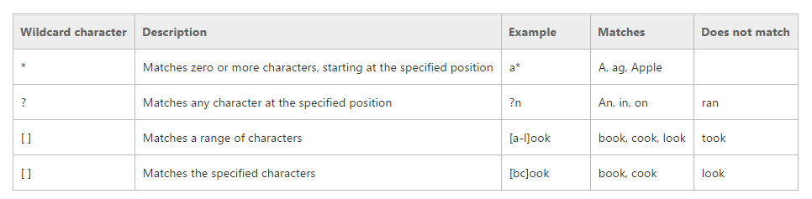
Support wildcards (globbing)
Allows to run against a group of resources rather than a single resource
Use –like “criteria*”
about_wildcards - https://technet.microsoft.com/en-us/library/hh847812.aspx
Globbing - https://msdn.microsoft.com/en-us/library/aa717088(v=vs.85).aspx
Notes:
Globbing - https://msdn.microsoft.com/en-us/library/aa717088(v=vs.85).aspx
About_wildcards - https://technet.microsoft.com/en-us/library/hh847812.aspx

Slide 46
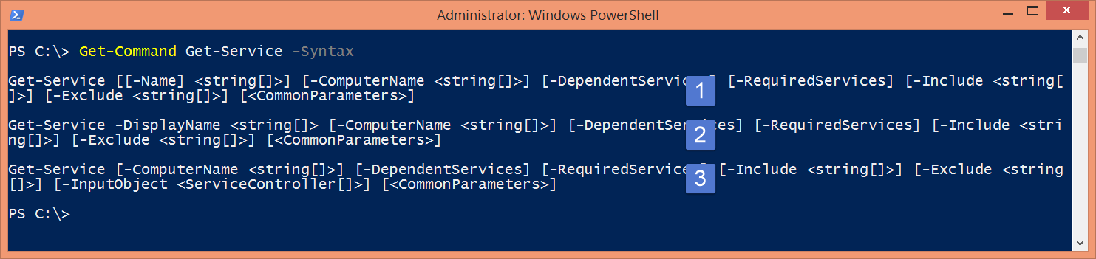
Use Parameter Sets
Allows to perform different scenarios from 1 cmdlet.
“Parameter Sets” allow to expose different groups of parameters based on the parameters specified by the user.
Notes:
https://msdn.microsoft.com/en-us/library/dd878348(v=vs.85).aspx

Slide 47
Use parameter Aliases
Improves parameters self-discovery
Allows object matching from pipeline
param(
[Parameter(Mandatory=$true)] [Alias('Name')] [string]$PackageName
)

Slide 48
Use Parameter Validation
[ValidateSet(<ValidationSet>)]
Provides validation using defined ‘Validation Set’
Validated at execution by PowerShell
Provides information to intellisense auto-completion
param(
[ValidateSet('Information','Warning','Error')]
[string]$EventType = 'Information‘ )
[ValidateScript(<scriptblock>)]
Provides validation using script block
param(
[ValidateScript({Test-Path –Path $Path})]
[string]$Path )
[ValidatePattern(<regex>)]

Slide 49
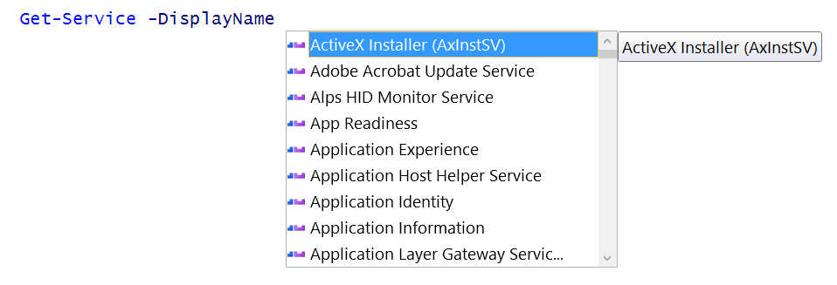
Build Argument Completion
PowerShell Syntax:
<Cmdlet> -Parameter <argument>

Slide 50
Argument Completion

Slide 51
Argument Completion
Syntax: Verb-<Prefix>Noun –Parameter <argument>
Available for both PS ISE and PS CLI*
Notes:
* Starting from PSv5

Slide 52
Building Argument Completion Approaches
#1 Using module ‘TabExpansionPlusPlus’
#2 Using native PowerShell
Module: TabExpansionPlusPlus
Cmdlets
Register-ArgumentCompleter
New-CompletionResult
PS compat: PS v3 - v5
Installation: PowerShellGet
Install-Module TabExpansionPlusPlus
Module: n/a
Cmdlets
Register-ArgumentCompleter
New-Object System.Management.Automation.CompletionResult
PS compat: PS v5

Slide 53

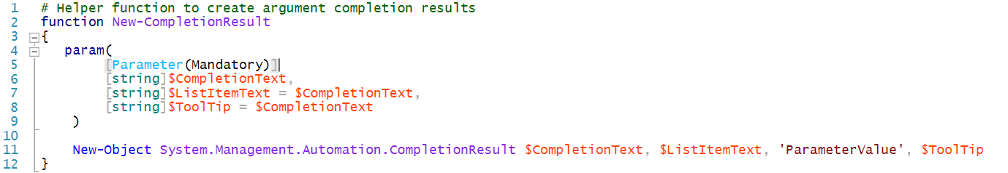

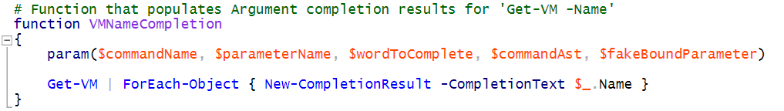
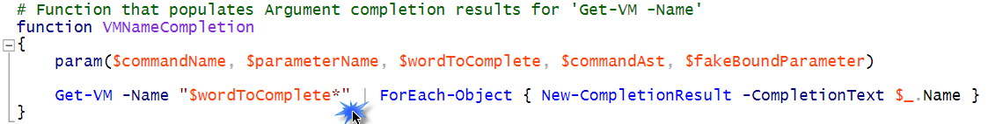

Building Argument Completion Using native PowerShell
DEMO
Helper function
Argument completer function
Register Argument completer

Slide 54
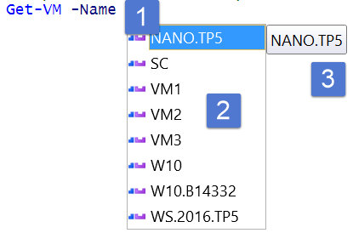
Building Argument Completion Using [System.Management.Automation.CompletionResult]
New-CompletionResult command takes three parameters:
CompletionText: The text inserted on completion
ListItemText: The text displayed in completion dropdown
Tooltip : The tooltip for items in ISE completion dropdown.

Slide 55
Building Argument Completion Using native PowerShell - Code
# Helper function to create argument completion results
function New-CompletionResult
{
param(
[Parameter(Mandatory)]
[string]$CompletionText,
[string]$ListItemText = $CompletionText,
[string]$ToolTip = $CompletionText
)
New-Object System.Management.Automation.CompletionResult $CompletionText, $ListItemText, 'ParameterValue', $ToolTip
}
# VM Name ############################################
# Function that populates Argument completion results for 'Get-VM -Name'
function VMNameCompletion
{
param($commandName, $parameterName, $wordToComplete, $commandAst, $fakeBoundParameter)
Hyper-V\Get-VM -Name "$wordToComplete*" | ForEach-Object { New-CompletionResult -CompletionText $_.Name }
}
# Register Argument Completer
Register-ArgumentCompleter -CommandName Get-VM -ParameterName Name -ScriptBlock $function:VMNameCompletion
# Experience argument completion for -VMName <TAB>
Get-VM -Name
# VM Id ##############################################
# Function that populates Argument completion results for 'Get-VM -Id'
function VMIdCompletion
{
param($commandName, $parameterName, $wordToComplete, $commandAst, $fakeBoundParameter)
Hyper-V\Get-VM -Name "$wordToComplete*" | ForEach-Object { New-CompletionResult -CompletionText $_.Id -ListItemText $_.Name -ToolTip $_.Status }
}
# Register Argument Completer
Register-ArgumentCompleter -CommandName Get-VM -ParameterName Id -ScriptBlock $function:VMIdCompletion
# Experience argument completion for -Id <TAB>
Get-VM -Id

Slide 56
Building Argument Completion Using TabExpansionPlusPlus
DEMO
Provides Argument Completers for most common PowerShell modules
Appx
Azure
CimCmdlets
Dism
DFS-N, DFS-R
DHCP Server
DNS Client, DNS Server
FailoverClustering
Group Policy
LocalAccounts
NetAdapter, NetSecurity
NetLBFO, NetQoS
PrintManagement
PnPDevice
PackageManagement
PowerShell Core
PowerShellGet
PowerShellDirect
SmbShare
SCVMM
DataONTAP
Available on GitHub at http://github.com/lzybkr/TabExpansionPlusPlus

Slide 57
Building Argument Completion Using TabExpansionPlusPlus - Code
# Helper function to create argument completion results
function New-CompletionResult
{
param(
[Parameter(Mandatory)]
[string]$CompletionText,
[string]$ListItemText = $CompletionText,
[string]$ToolTip = $CompletionText
)
New-Object System.Management.Automation.CompletionResult $CompletionText, $ListItemText, 'ParameterValue', $ToolTip
}
# VM Name ############################################
# Function that populates Argument completion results for 'Get-VM -Name'
function VMNameCompletion
{
param($commandName, $parameterName, $wordToComplete, $commandAst, $fakeBoundParameter)
Hyper-V\Get-VM -Name "$wordToComplete*" | ForEach-Object { New-CompletionResult -CompletionText $_.Name }
}
# Register Argument Completer
Register-ArgumentCompleter -CommandName Get-VM -ParameterName Name -ScriptBlock $function:VMNameCompletion
# Experience argument completion for -VMName <TAB>
Get-VM -Name
# VM Id ##############################################
# Function that populates Argument completion results for 'Get-VM -Id'
function VMIdCompletion
{
param($commandName, $parameterName, $wordToComplete, $commandAst, $fakeBoundParameter)
Hyper-V\Get-VM -Name "$wordToComplete*" | ForEach-Object { New-CompletionResult -CompletionText $_.Id -ListItemText $_.Name -ToolTip $_.Status }
}
# Register Argument Completer
Register-ArgumentCompleter -CommandName Get-VM -ParameterName Id -ScriptBlock $function:VMIdCompletion
# Experience argument completion for -Id <TAB>
Get-VM -Id

Slide 58

Others

Slide 59
Building Snippets
Include code snippets in module
Subfolder “Snippets”
Files syntax: <module>.snippets.ps1xml
Cmdlets
New-ISESnippet
Import-ISESnippet –Module <module> -ListAvailable
Get-ISESnippet

Slide 60
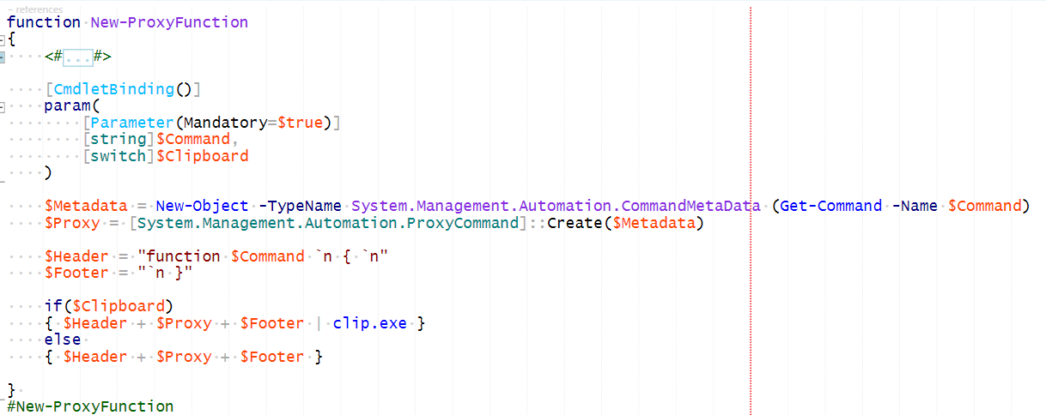
Building “Proxy Functions”
Complex – Modify default behaviour of cmdlets
Use only when needed.

Slide 61
Module Management

Slide 62
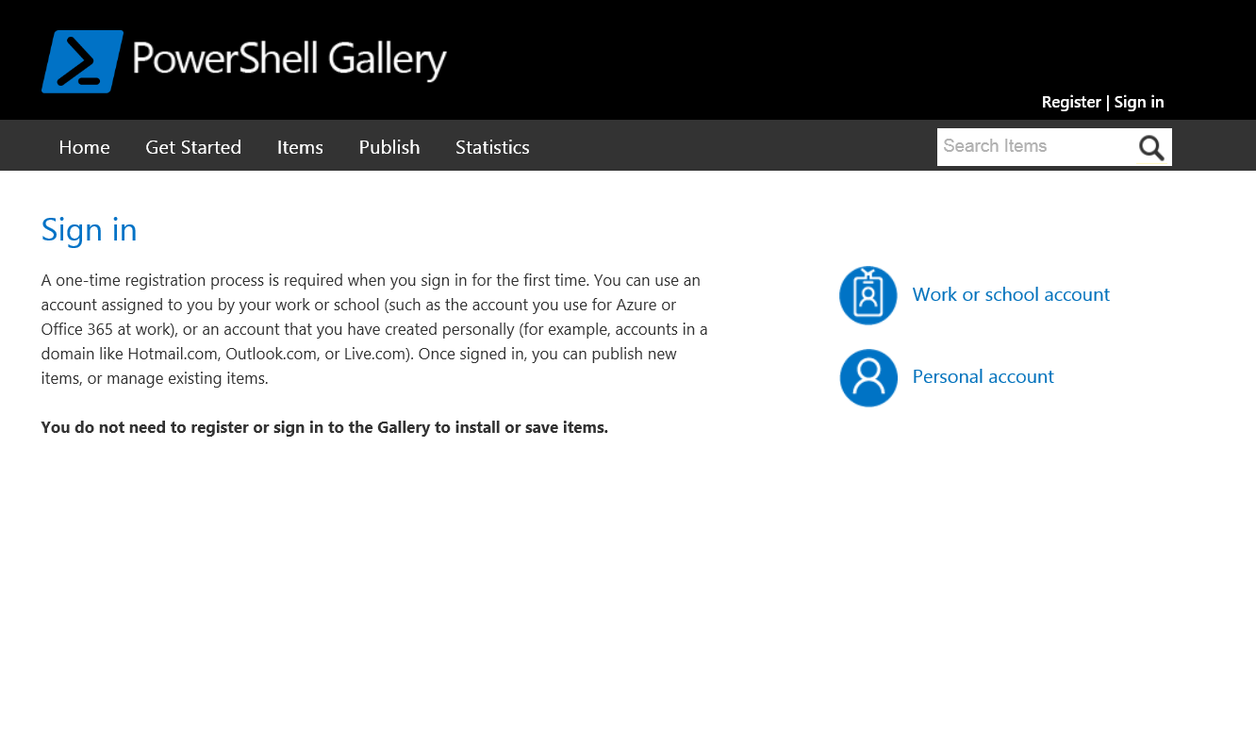

Public PowerShell Gallery
External repository for PowerShell resources
Modules, scripts, DSC resources
URL: http://www.powershellgallery.com

Slide 63
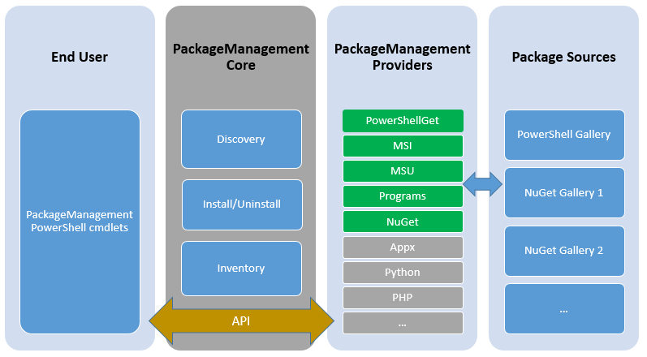
Module Management Package Management (OneGet) versus PowerShellGet
Package Management
Allows automation of SDII (Software Discovery, Installation & Inventory)
PowerShellGet
Package management for PowerShell resources
Modules
Scripts
DSC resources

Slide 64
Module Management SDII (Software Discovery, Installation & Inventory)
Find resources
Find-Module
Find-Script
Find-DscResource
Install resources
Install-Module
Install-Script
Get resources
Installed-Module
Installed-Script

Slide 65
Module Management Publishing PowerShell resources
Publish resources to PSGallery
Publish-Module
Publish-Script
Requires
(NuGet) API key
Module manifest (Version, Author, LicenseURI)

Slide 66
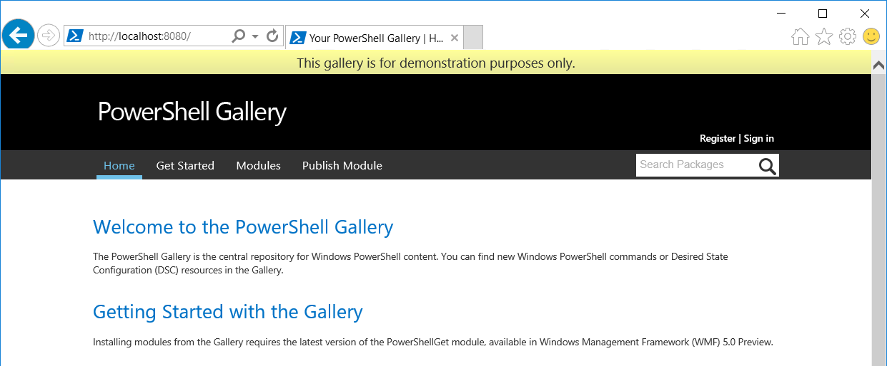
Private PowerShell Gallery
Internal trusted repository for PowerShell resources
Currently in preview on GitHub
Notes:
https://github.com/PowerShell/PSPrivateGallery

Slide 67
Summary
Provide consistent behavior across all PowerShell cmdlets
Provide consistency for
For Cmdlet naming
For Parameter usage and naming
For Object (model) and Property/Method naming
Makes learning and remembering faster and easier

Slide 68

ITPROceed Demo Code
All presentation demo code is available at https://github.com/roggenk/ITPROceed2016
Enjoy

Slide 69

Be the first to know
Follow Technet Belgium
@technetbelux
Subscribe to the TechNet newsletter
aka.ms/benews

Slide 70















Special thanks to our sponsors

Slide 71
Belgiums’ biggest IT PRO Conference

